Slide 1

Electric Vehicle Price Prediction
--- Chetan Phartale ( Batch 34 )

Slide 2
Introduction
Around 1832, Robert Anderson develops the first crude electric vehicle.
After 1870s electric cars became practical.
In 2021 almost 2332 thousand electric cars were sold in the Europe.
Europe accounts for 27.94% sale of electric cars.
The Electric Vehicles market in in Europe is projected to grow by 17.78% (2022-2027).
Resulting in a market volume of US$340.70bn in 2027.

Slide 3
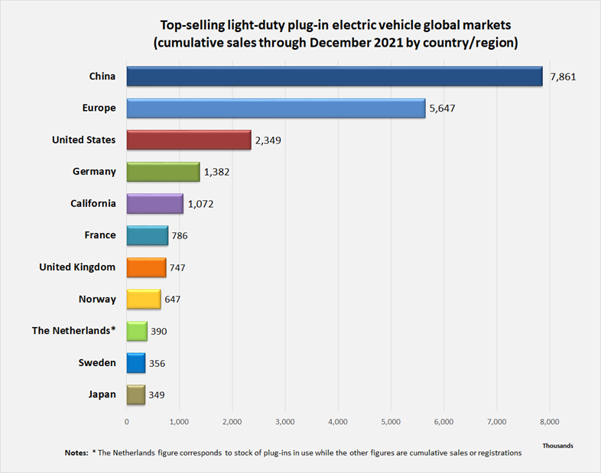
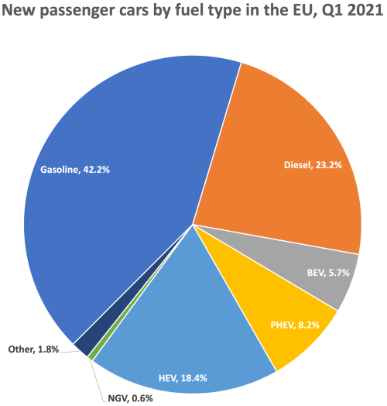
EVs encounter total of 32.3% market share in Europe.
Europe Is the second largest market for EVs.

Slide 4

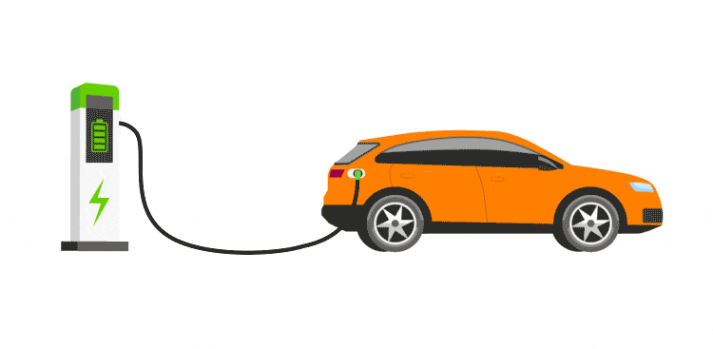
Objective
The main objective of the data is to predict cost of electric vehicle based on Power transmission, Segment type, Range and Acceleration per second.

Slide 5
Data Source
The data is taken from Kaggle depository.
Here is link :-
https://www.kaggle.com/datasets/kkhandekar/cheapest-electric-cars
Data description
Numerical Variable | Categorical variable | dependent variable (Y)
AccelSec, TopSpeed_KmH, FastCharge_KmH, Range_Km, Efficiency_WhKm, Seats | Brand, Model,, RapidCharge, PowerTrain, PlugType, BodyStyle, Segment | PriceEuro

Slide 6
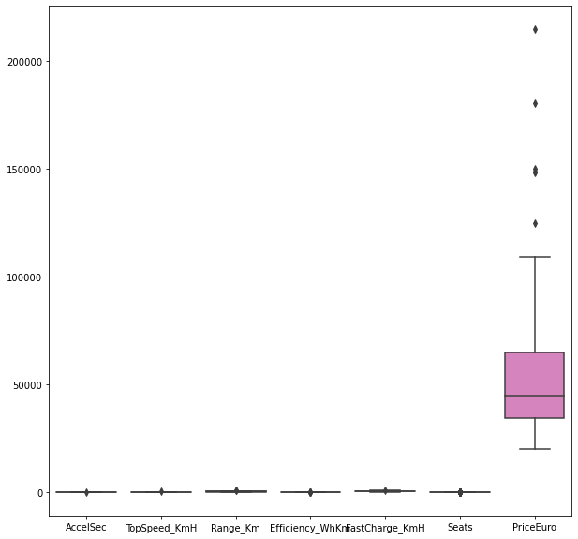
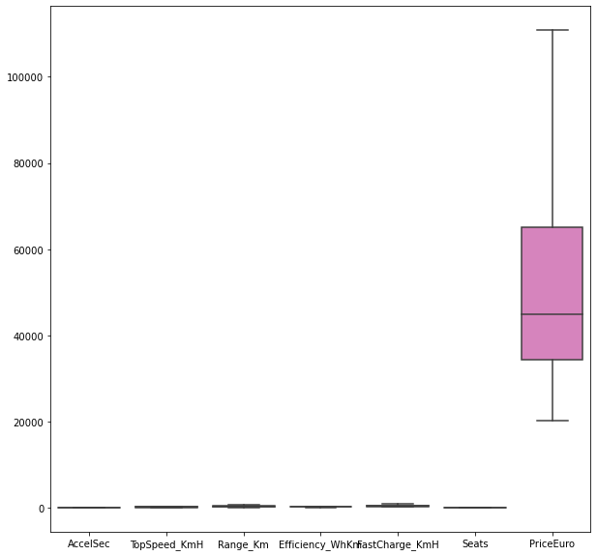
EDA
Outliers: The outliers which were present in the data are treated with Winsorizing method.
Missing Values: The missing values are replaced with mean.

Slide 7
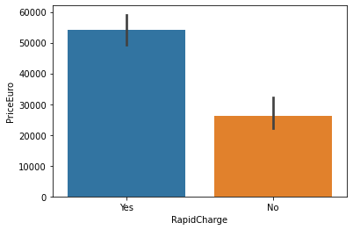
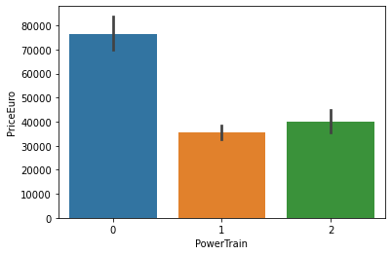
Data visualization

Slide 8
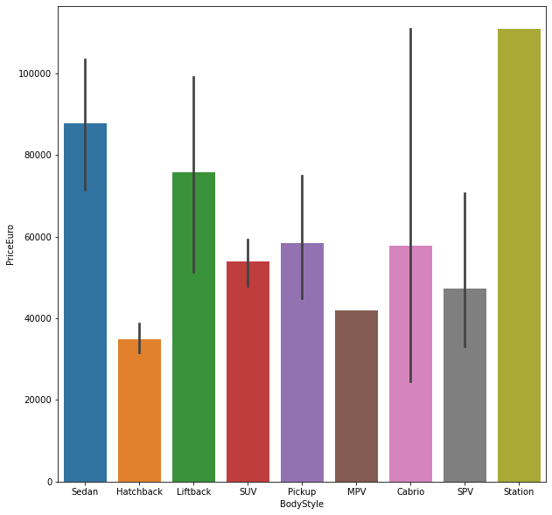
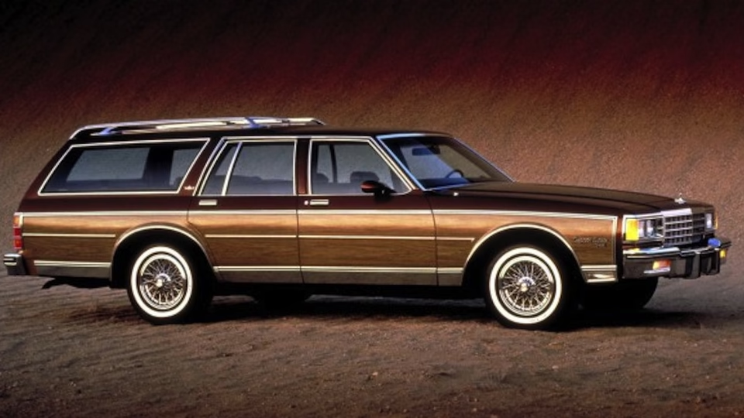
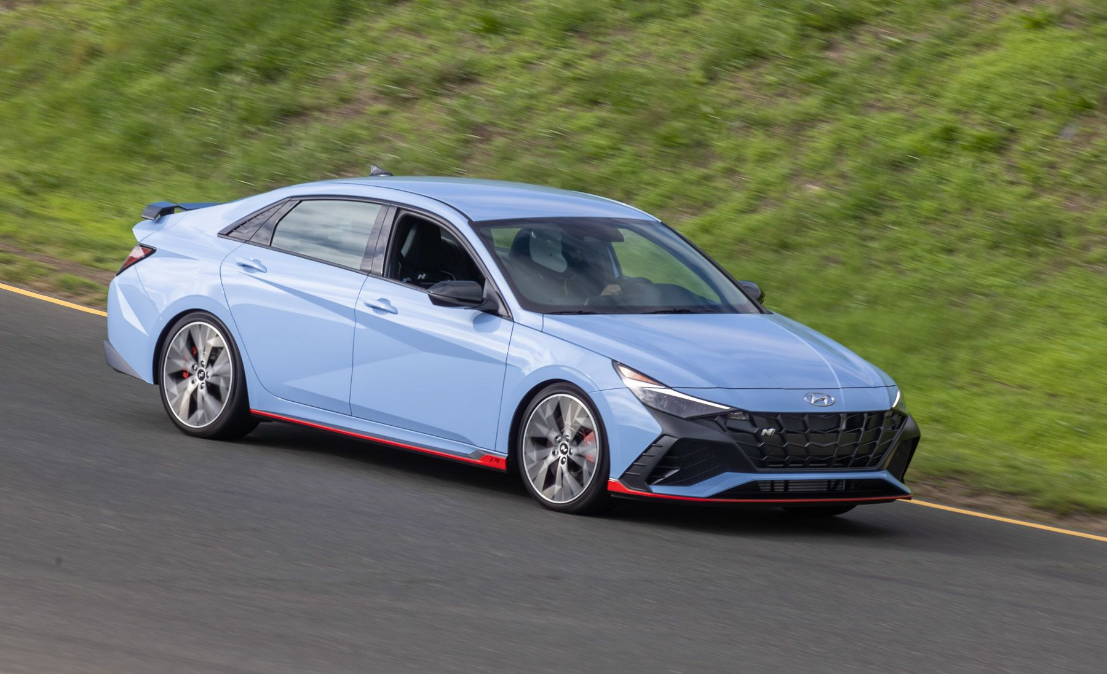
Data visualization

Slide 9
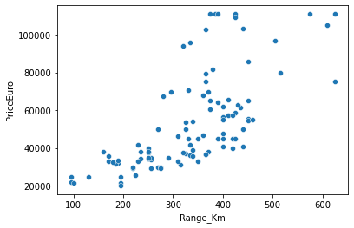
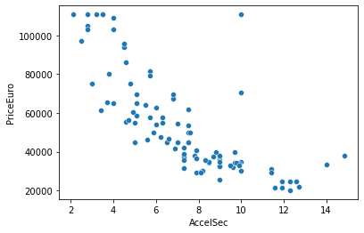
Data visualization

Slide 10
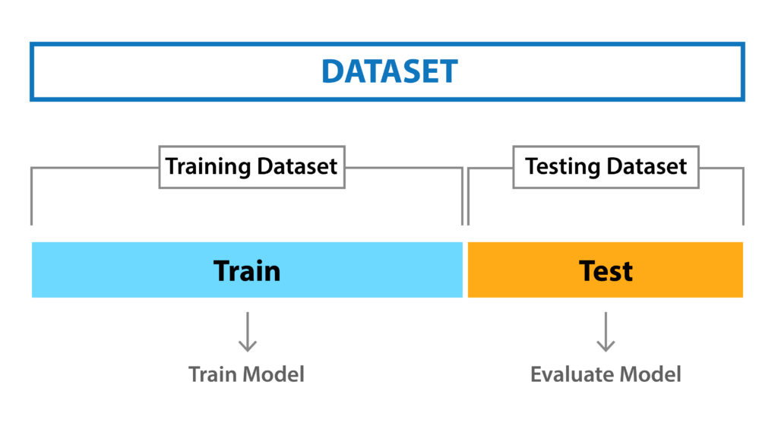
Data partition
Firstly all the categorical data is converted into numerical using Label Encoder.
After conversion the partition is done using ‘train_test_split’ from Sklearn library.
70% data is kept in train, whereas 30% is used for test.

Slide 11
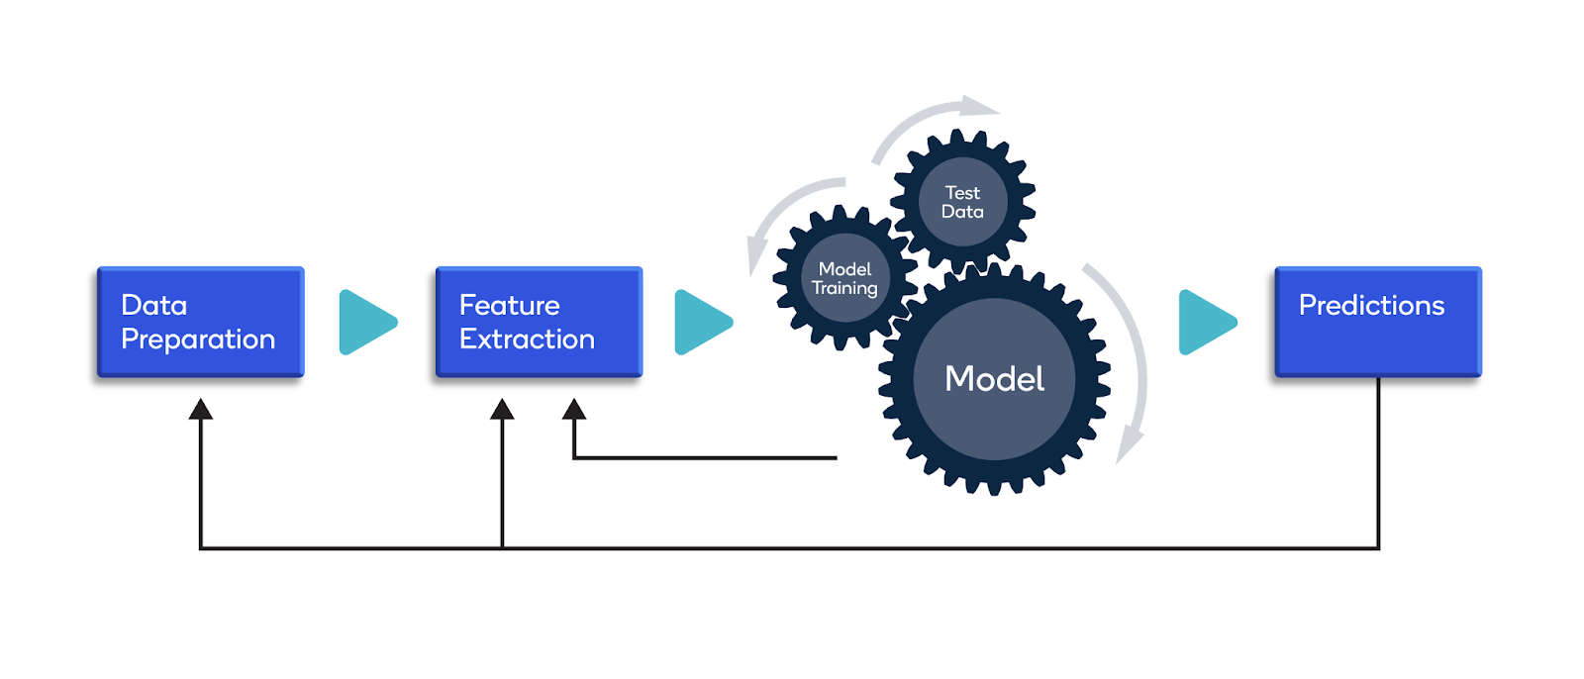
Machine Learning model
To perform the machine learning ‘Random Forest regression’ Model is used.
After performing grid search we have used the best parameters for pruning
Number of trees are 10.
Min sample split is kept as 5.
Min leaf split is kept as 3.
And number of braches are assigned as 3.

Slide 12
Model train & test accuracy
We performed various machine learning models on this dataset.
As the accuracy of Random Forest model is satisfactory for both train and test data, we chose results of that model to present.
Model | Train accuracy | Test Accuracy
Decision Tree | 81% | 74%
Random Forest | 88% | 81%
Gradient Boosting | 83% | 78%

Slide 13
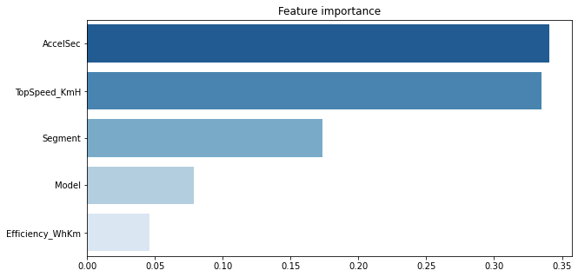
Important variables
Top 5 important variables for this analysis are.

Slide 14
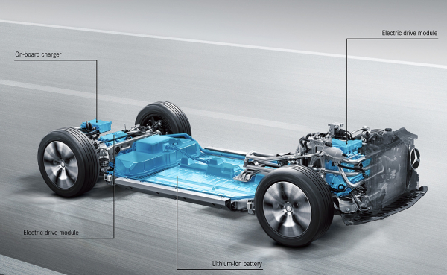
Analysis and Summery
Based on data visualization, cars having dual motors, rapid charge, Higher range have high price.
Model can predict the price of car with 81% accuracy.
High Influence variables according to Model are: Acceleration per sec, Top Speed, Segment and Efficiency, Power Transmission,.

Slide 15
Suggestion
The range of electric vehicles affects price highly, so lightweight & economical storage batteries should introduce which will improve the range and reduce the cost.
The charging Components should be improvised to reduce the cost.

Slide 16


